Slide 1
Therapeutic drugs 2
Dr.Nathasha Luke
Department of Pharmacology

Slide 2
So far….
Basic principals of managing poisoning
Paracetamol overdose

Slide 3
Case scenario
A 22 year old female is brought to the night casualty ward by her husband.She has had a quarrel with him and then taken some pills from her grandmothers medicine.She is drowsy and sweaty.
You are the house officer attending to this patient. What will be the next step of management ?

Slide 4
Poisoning with unknown drugs
History
Examination
Investigations

Slide 5
History
Agent
Amount
Timing

Slide 6
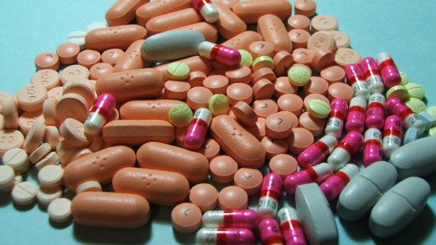
History
Her husband has brought the left over drugs of what she has taken.
What will be your next step to identify ?

Slide 7
The grandmother has lost her clinic books one month back
She is on treatment for diabetes, hypertension, psychiatric illness and heart disease

Slide 8
The patient does not exactly remember what medicine and what amount she consumed
Counting the pills also fails as the grandmother has not had good compliance

Slide 9
What would you do…….

Slide 10
Examination

Slide 11
Cluster of symptoms
Clinical feature s | Drug
Hypertonia Hyperreflexia Dilated pupils | TCA,SSRI
Hypotonia,Hyporeflexia Respiratory depression | Benzodizapines
Pinpoint pupils Respiratory depression Hypotension | Opioids
Vomitting Tinnitus ,Deafness Acidotic breathing | Salicylate

Slide 12
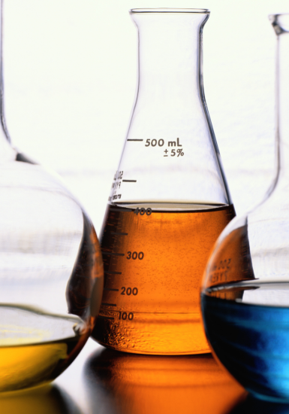
Investigations
Toxicological investigations
-blood levels : Paracetamol,Lithium,Iron,Theophilline
-Toxicological screening of urine and blood
Non toxicological investigations

Slide 13
Non-toxicological investigations
Investigation | Anticipated abnormality | Agent responsible
Blood sugar | Hypogycemia | Antidiabetic drugs Salicylates
ABG | Acid base disturbances | Salicylates
Serum electrolytes | Hypokalaemia | Theophilline Salbutamol Insulin Diuretics
 | Hyperkalaemia | Digoxin
Liver function tests | Elevated transaminases | Paracetamol
Prothrombin time | Prolongation | Paracetamol Warfarin
ECG | Arrythmias | ???

Slide 14
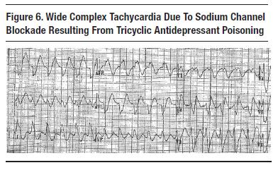
ECG changes anticipated in therapeutic drug poisoning

Slide 15
Antidotes in drug poisoning
Agent | Drug overdose
Beta blocker | Theophilline
Octriotide | Oral hypoglycemic drugs
Deferoxamine | Iron
Digoxin Immune Fab antibody | Digoxin
Flumazenil | benzodiazepine
Glucagon | Beta blocker/Calcium channel blocker
Naloxone | Opioid
Protamine sulfate | Heparin
Atropine | Beta blocker

Slide 16
Lets look into the management of some specific drug toxicities ….
Antidepressants
Benzodiazepines
Opioids
Digoxin
Lithium
Gentamicin

Slide 17
Benzodiazapines
sedative /hypnotic agents
act by potentiating the effects of the inhibitory neurotransmitter GABA within the CNS.
Examples include:
Alprazolam
Clonazepam
Diazepam
Midazolam

Slide 18
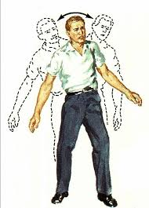
Features of Overdose
ataxia
drowsiness
Nystagmus
slurred speech
decreased level of consciousness
Respiratory depression
Hypotension, bradycardia and hypothermia- in larger doses

Slide 19
Management
Monitor for respiratory depression/cardiac monitoring
Antidote-flumazenil-only indicated if respiratory depression
Mechanical ventilation
Supportive management

Slide 20
Antidepressants
Tricyclic anti depressents –amitriptyline,imipramine
MAO inhibitors
SSRI

Slide 21
TCA toxicity
Toxic effects due to
Inhibition of reuptake of monoamines at nerve endings (seratonin/noradrenaline )
Anticholinergic effects
Na/K channel blockage

Slide 22
Clinical features of TCA overdose
Cardiovascular system | CNS | Anticholinergic symptoms
Sinus tachycardia | Drowsiness | Dry mouth
Prolonged QRS/QT | Coma, Confusion | Blurred vision
ST/T wave changes | Hypertonia | Dilated pupils
Hypotension | Exaggerated reflexes | Urinary retention
Cardiogenic shock | Seizures

Slide 23
TCA overdose
Cardio toxicity usually is the cause of death
Usually appear with in 4 hours
ECG monitoring
Give NaHCO3 if arrhythmias

Slide 24
Case
A 45 year old male is brought to the emergercy treatment unit, found semiconcious in his room.He is on treatment with imipramine for depression.Examination findings are
-drowsy
-constricted pupils
-hypertonia with exaggerated reflexes
BP-80/50mmHg
PR-120/min
1.What will be your tentative diagnosis ?
2.State the most important investigation in this patient

Slide 25
SSRI
Unlikely to cause fatal toxicity unless very large amounts ingested
Cardiotoxicity less
Can cause seratonin syndrome
-restlessness
-hypertonia
-hyperreflexia
-hyperpyrexia
Supportive and symptomatic management

Slide 26
Opioids
Clinical features
-pinpoint pupils
-respiratory depression
-impaired level of conciousness
-Hypotension
-Vomitting

Slide 27
Management
Antidote –IV naloxone
Need repeated doses as short half life
Caution – Precipitate withdrawal symptoms in opioid dependance

Slide 28
Case
47 year old female has consumed her husbands pills taken for high blood pressure in a suicidal attempt.You identify the agent as atenolol.
What are the symptoms you would anticipate?
What are the antidotes for beta blocker overdose?

Slide 29
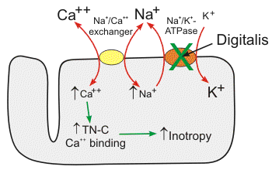
Digoxin Mechanism of Action
Inhibits Cardiac Na/K ATPase which indirectly increases intracellular Ca concentration
Increase cardiac excitability and contractility
Increases AV node refractory period by increasing vagal tone
Has a low therapeutic index…

Slide 30
Digoxin overdose –mechanism of toxicity
Increase cardiac excitability and contractility
Increases AV node refractory period by increasing vagal tone
Hypokalaemia /hypomagnisaemia : increases risk of digoxin toxicity
Ventricular ectoptics/tachyarrythmias
Bradyarrythmias

Slide 31
Digoxin overdose –clinical features
Nausea/diarrhoea
Arrythmias
-ventricular ectopics
-SVT/VT/VF
-heart block
Confusion /agitation
Xanthopsia
Hyperkalaemia

Slide 32
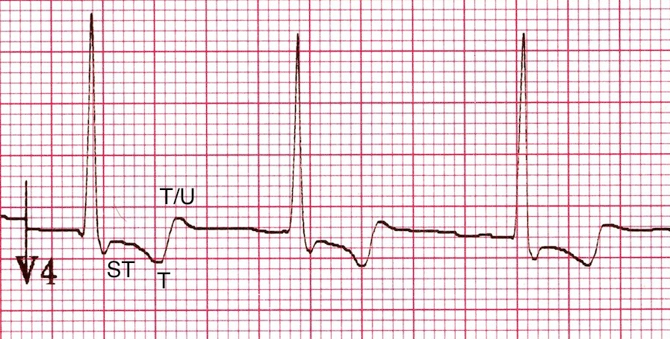
Reverse tick sign –ST depression with Digoxin –seen in therapeutic doses as well

Slide 33
Management of Digoxin toxicity
Activated charcoal
Antidote: digoxin binding antibody fragment

Slide 34
Salicylates overdose –features
Metabolic acidosis
Respiratory alkalosis
Hyper/hypoglycemia
Pyrexia
Nausea and vomiting
Seizures
Tinnitus
Deafness

Slide 35
Management
Gastric decontamination
Activated charcoal
Alkalinizing urine
Hemodialysis

Slide 36
Lithium
Commonly used to treat depressive and bipolar affective disorder
Low therapeutic index
Toxicity
-acute
- chronic
Multisystem dysfunction with toxicity
T1/2: 12-26h

Slide 37
Lithium toxicity
Excretion- renal
Reabsorbed in PCT- paired with Na absorption
Reabsorption of lithium is increased and toxicity is more likely in patients who are hyponatremic or volume depleted

Slide 38
Identifying lithium toxicity
Clinically
-fine tremors/ polyuria/polydipsia/metallic taste are side effects of lithium. Can occur in therapeutic doses
-Features suggestive of Li toxicity include
Coarse tremor
Blurred vision
Muscle weakness
Ataxia
Slurred speech
Vomiting
Severe diarrhoea
Severe polyuria
Confusion
Seizures

Slide 39
Identifying lithium toxicity
Biochemical parameters
Lithium levels …………

Slide 40
Lithium levels
Routinely monitored in patients on Lithium
desired serum levels ----0.6-1.2 mEq/L
Toxicity - > 1.5 mEq/L
Question
Find how monitoring of Lithium levels are done in patients on Lithium
What are the other investigations recommended routinely in patients on lithium?

Slide 41
Management –Lithium toxicity
Urgent lithium level and renal function
Hydration
Treat electrolyte imbalances
Haemodialysis in severe toxicity

Slide 42
Gentamicin toxicity
High risk with
-high dose
-long duration of therapy
-dehydration
-renal dysfunction
-co administered nephrotoxins
Can cause
-ototoxicity-can be irreversible
-nephrotoxicity

Slide 43
Thank you…..

